Slide 1
Gen AI Agent Zero
Vedant Bhatter Lou DeZeeuw Preetha Kumar Rishitha Reddy Kallu Gargi Tawde

Slide 2
Solving Incidents Through the Power of AI
Once an incident is opened, assign a Gen AI agent to interact with the user directly
Why
Problem statement – ServiceNow handles countless incident reports daily. Many of these are simple problems that could be handled easily by AI. Introducing… Gen AI Agent Zero!
Value Proposition – Gen AI Agent Zero will streamline the process of dealing with incident reports. By solving simple incident reports, it will allow the DT team more time to focus on tackling bigger issues.
Why is the idea labelled as innovative? AI is one of the biggest innovations that we have seen in years. By utilizing AI to help us work, we cut the amount of time needed to deal with simple incident reports, freeing up people to work on harder problems.

Slide 3
Proposed Solution
It can be frustrating to experience simple issues in the workforce. You just want to get on with your day, but you're having an issue with MFA, or instance access... And a ticket will take a while to be resolved. Introducing Gen AI Agent Zero! Gen AI Agent Zero lowers the time it takes to get a ticket resolved.
Target Audience
Incident reporters
DT
Use Cases
Simple incident reports such as:
Instance Access
Multifactor authentication issues
Licensing and app permission issues

Slide 4
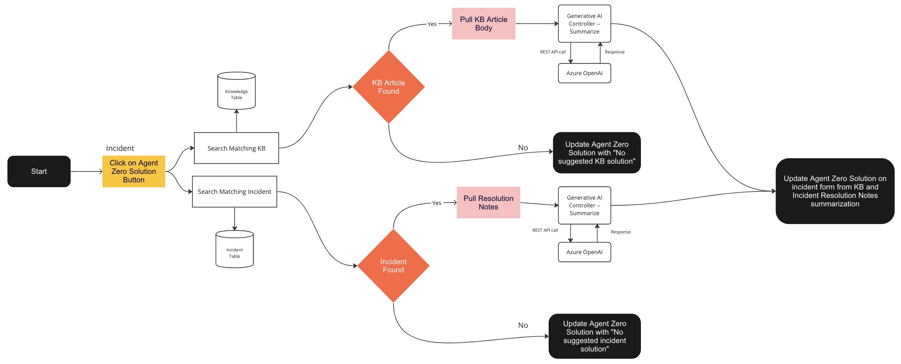
Gen AI Agent Zero Implementation
Technology stack: Flow Designer, UI Actions, Generative AI Controller Spoke
What we need: Access to GenAI Controller Spoke (currently reserved for specific teams within ServiceNow)

Slide 5
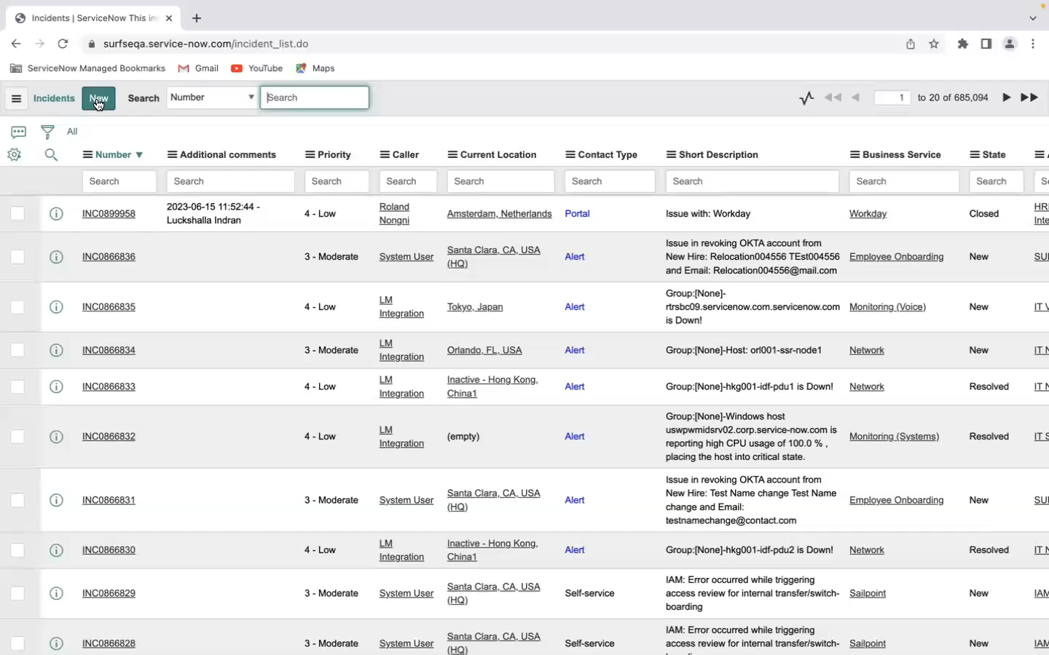
Demo

Slide 6
Future Roadmap
Improving on Gen AI Agent Zero
Making Gen Ai Agent Zero an interactive Bot
Including work notes/additional comments from the incident
Getting access to dev instance and Gen AI spoke to finish our implementation
Making Gen AI Agent Zero an interactive bot
Including Work Notes/Additional Comments fields from the incident
Getting access to dev instance and Gen AI spoke to finish implementation

